Slide 1
Deep Learning Based Feature Extraction Methods for Coyote Howling Detection
Mid-Presentation
Coyote2-Machine Learning

Slide 2
CONTENTS
01
02
03
Team Members
Introduction
Methodology
04
05
06
Expected Effect
Process
Q&A

Slide 3







Team Member
Yejin Lee
Heesun Jung
Youngbin Kim
Computer Science
Hallym University
Computer Science
Hallym University
Computer Engineering
Kwangwoon University
Bokyung Kwon
Jihyeon Park
Griffin Pegg
Computer Engineering
Kwangwoon University
Computer Science
Jeju National University
CNIT
Purdue University

Slide 4

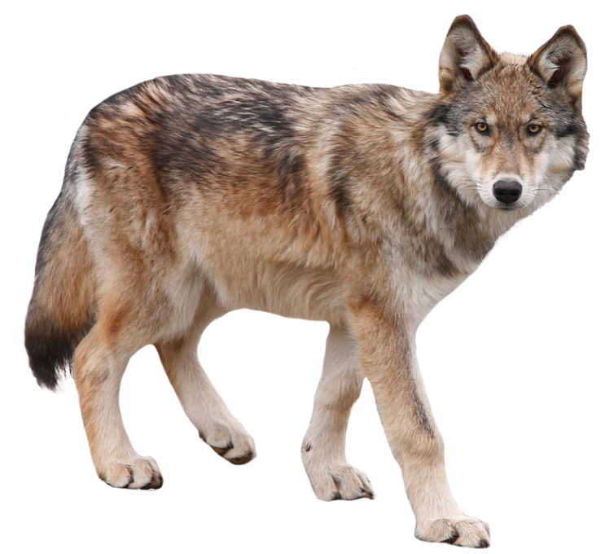
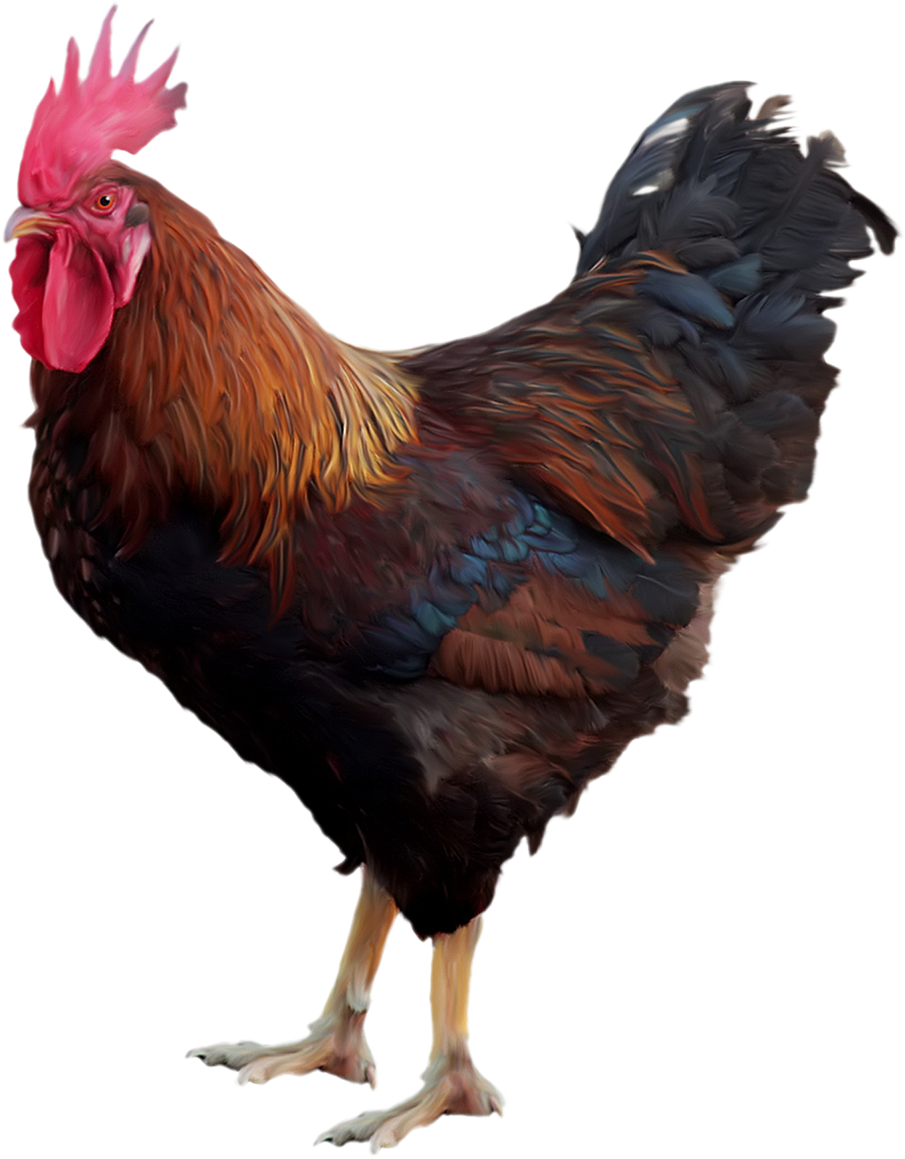
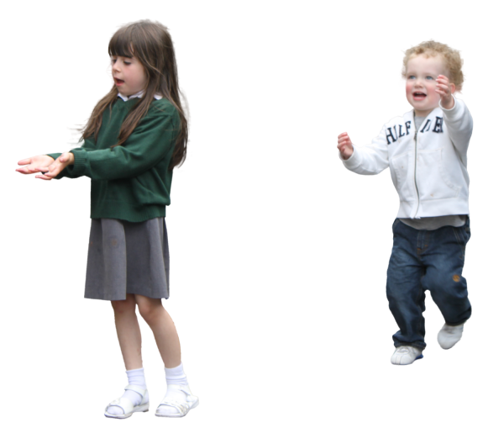
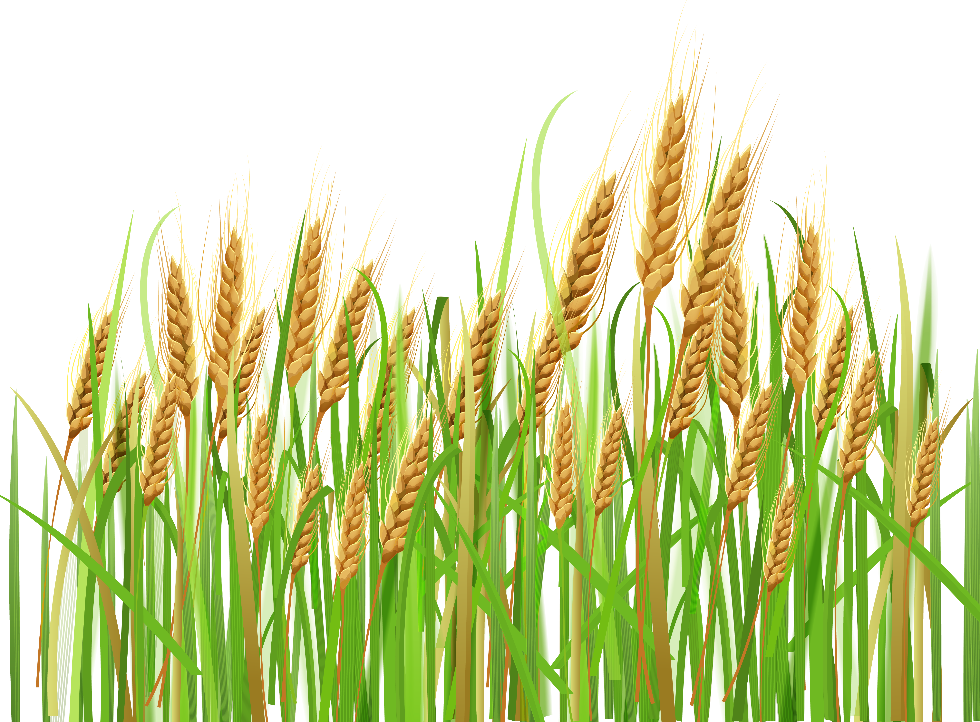
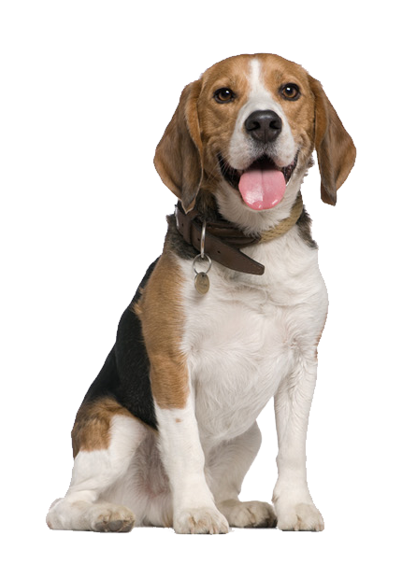
Introduction
There is substantial damage to livestock, human costs, and crops
by coyote in several farms.
Continuous Economic Losses

Slide 5
Introduction
The number of livestock killed by coyotes among those killed by predators
[UDSA, 2015]
But solving the problem with.. Non-technical approach
Technical Approach
is needed.

Slide 6
Introduction
💡 Platform Architecture
Raspberry PI
Network Team
Application
Server
MQTT
LTE/WIFI
Machine
Learning
- Figure out if it's coyote or not using ML model in Raspberry Pi.
- Input: audio feature from LoRa

Slide 7
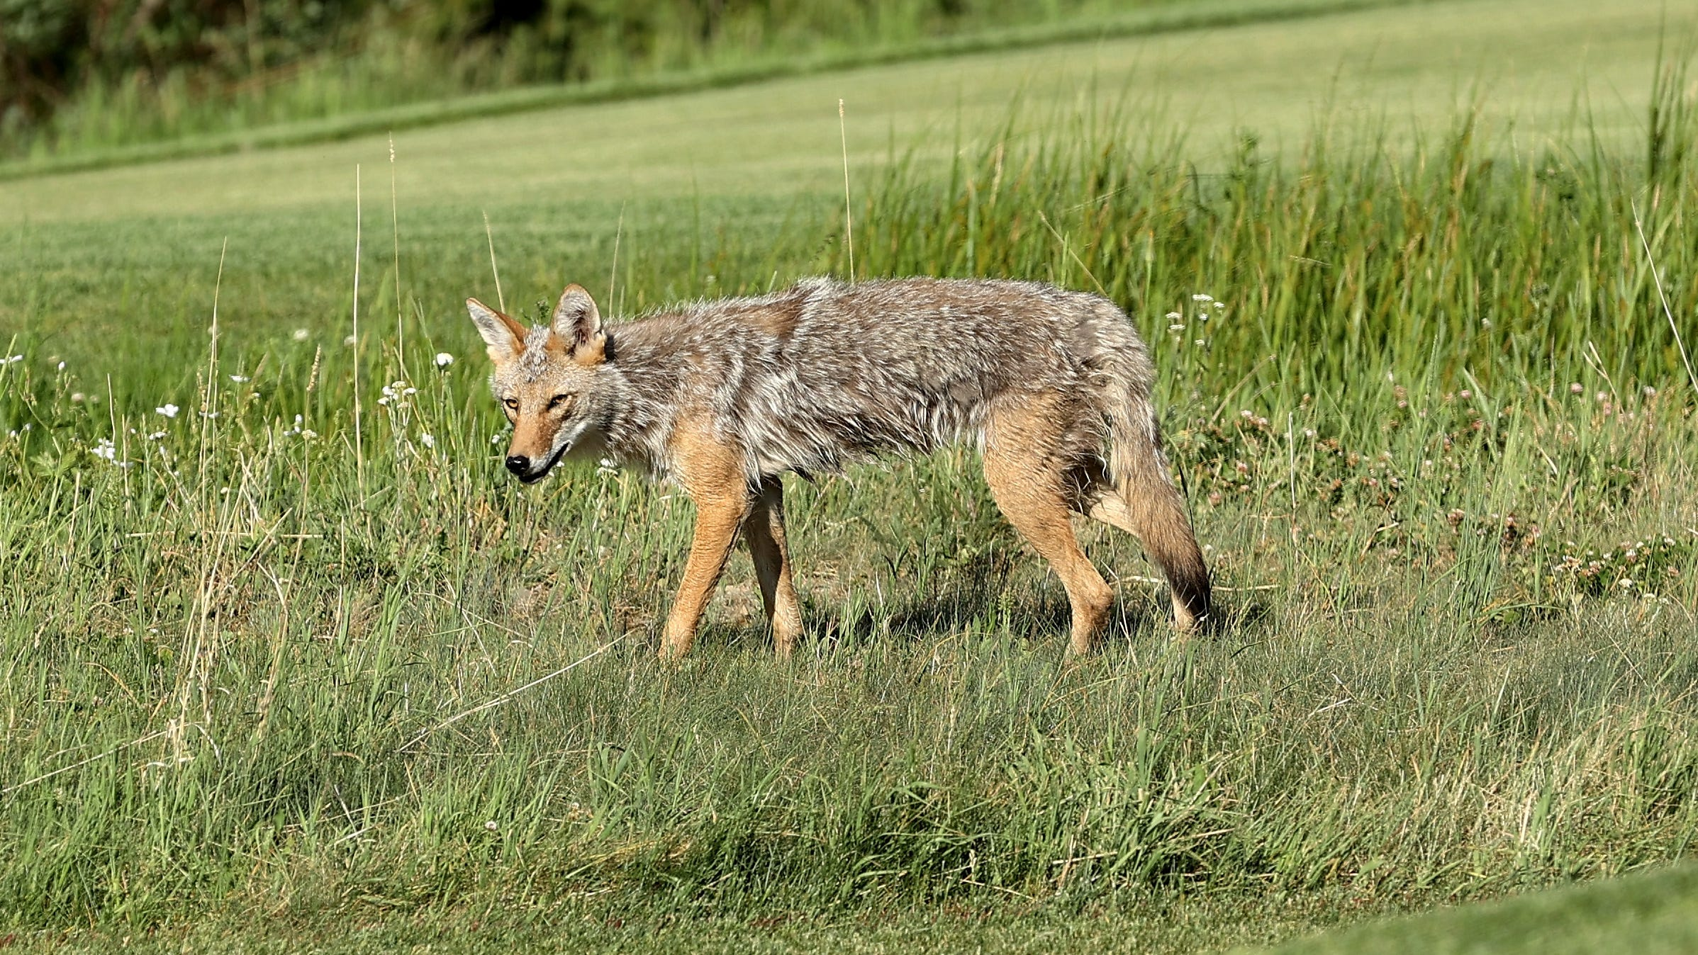

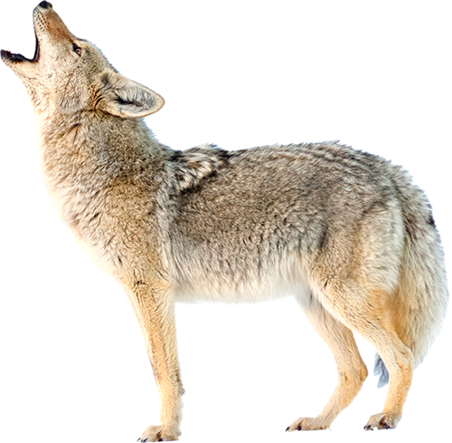
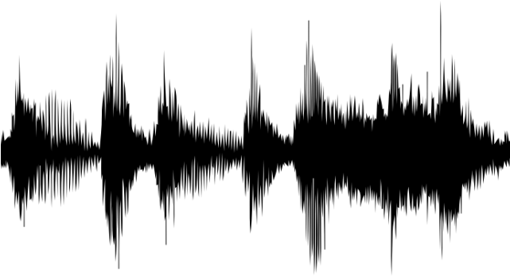
Introduction
💡 Common ways to detect coyote …
IMAGE
AUDIO
💡 AUDIO
- Coyotes have a habit of making frequent howling.
- The transmission distance range of the howling is higher than image.

Slide 8



Methodology
💡 Dataset problem
: clean, reliable data is needed but there is not enough dataset.
 | Coyote | Non-Coyote
Plan & Problem | - National Park Service - Colorado State University : Copyright, Data pre-processing Problem | Google Research Audio dataset : Data pre-processing Problem
Temporary | Extract audio from Youtube and split to 5 seconds

Slide 9
Methodology
134
117
29
💡 Train/Test Dataset
Coyote vs Non-coyote(dog, chicken…)
coyote | 586
dog | 480
chicken | 94
coyote | 134
dog | 117
chicken | 29
Non-coyote
Train data(8)
Test data(2)
TOTAL
Coyote : 720 Dog : 597 Chicken : 123

Slide 10
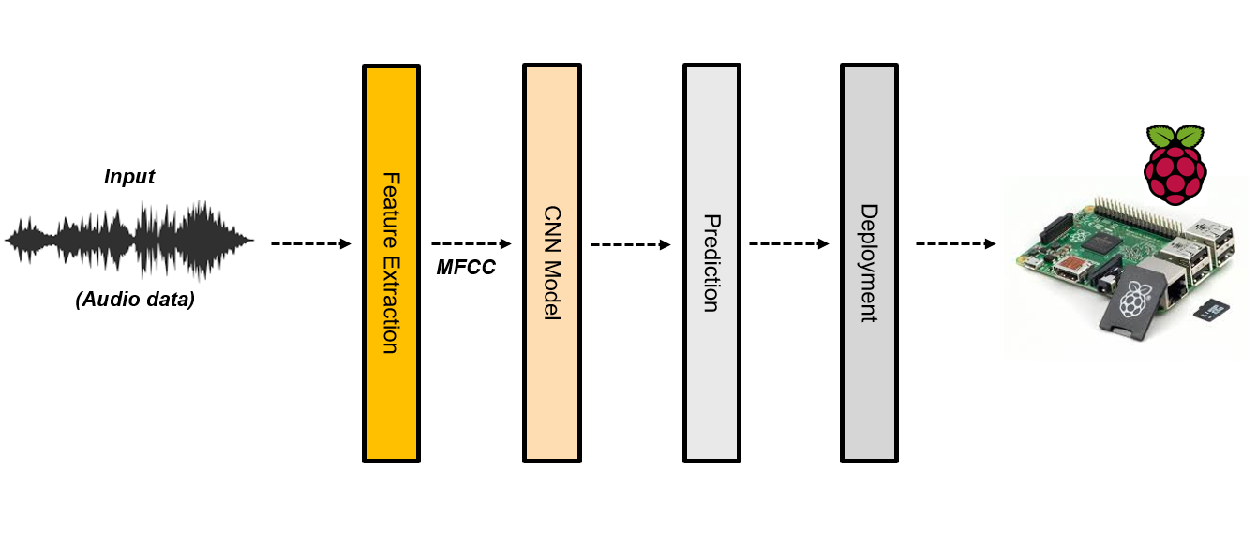
Methodology
💡 Machine Learning – Overall architecture

Slide 11
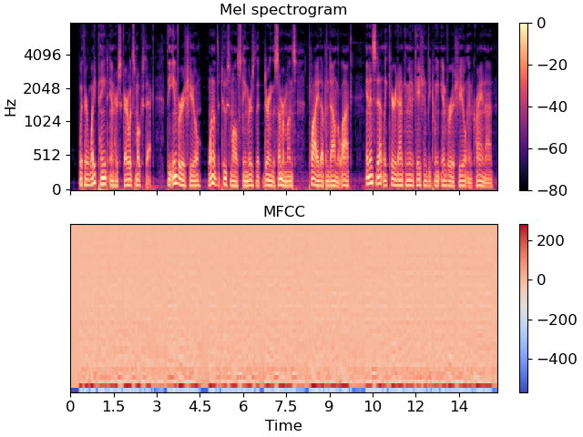
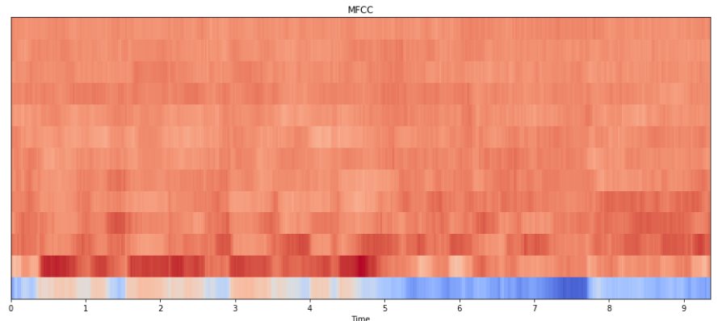
Methodology
💡 Feature Extraction
Mel Spectrogram
➡ A spectrogram where the frequencies are converted to the Mel scale
Gammatone Cepstral Coefficient(GTCC)
➡ Use a gammatone filer to extract an audio feature
➡ Use discrete cosine transform (DCT), to reduce the dimension of audio feature
Mel Frequency Cepstral Coefficient(MFCC)
➡ One of the most broadly used methods in audio recognition.
➡ Apply Filter Bank based on Mel Scale on Spectrum
Mel Spectrogram
MFCC
Combination of Features
Research have shown that the combination of several features makes better performance

Slide 12

Methodology
💡 Feature Extraction
Audio and music processing in Python
Extract features from sound files
Features were extracted and saved as binary files

Slide 13
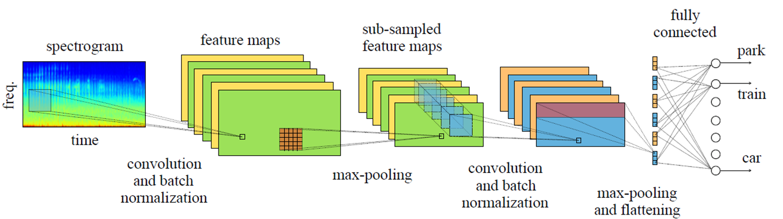
Methodology
💡 Convolutional Neural Network (CNN)
Deep learning algorithm
Uses numerous layers to detect different features
Most commonly used to analyze image data, but can be used with audio data
➡ Must extract features that look like images (like a spectrogram or MFCC)

Slide 14
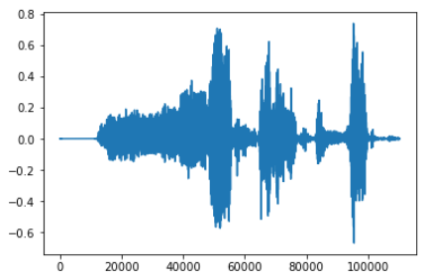
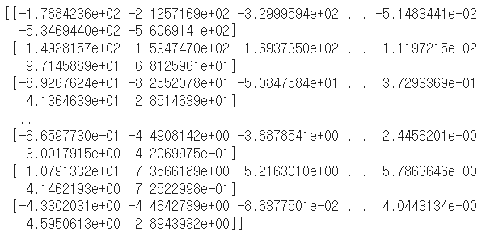
Methodology
💡 Audio Feature Training
Amplitude
Librosa
Sampling rate
.wav File
Audio Feature
MFCC

Slide 15
Methodology
- Model Architecture
Conv 2D
Fc Layer
Yes
Conv 2d
ReLU
Maxpool 2D
Conv 2D
Conv 2D
Conv 2d
ReLU
Maxpool 2D
Conv 2d
ReLU
Maxpool 2D
Conv 2D
Conv 2d
ReLU
Maxpool 2D
No
- Model Information
➢Loss : CrossEntropyLoss
➢Optimizer: Adam
➢Learning rate : 0.001
➢Batch size : 10
➢Epoch : 100

Slide 16
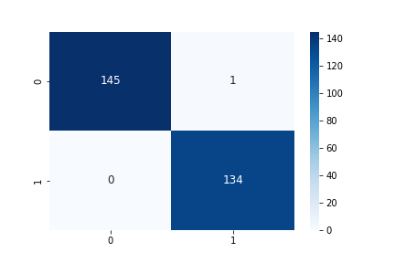
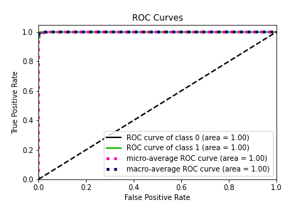
Experiment Result
- Confusion Matrix
- ROC curve
Vail set: Loss: 0.0324
Accuracy: 279/280 (100%)

Slide 17


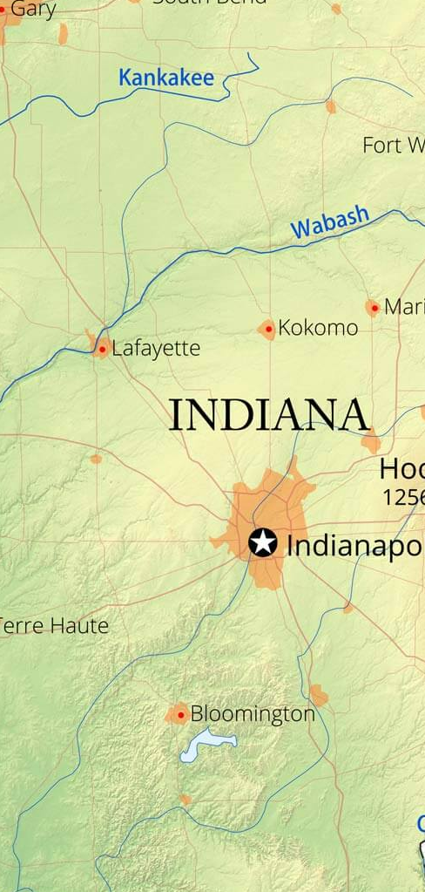


Contribution
Building Infrastructure
Increase efficiency in managing coyote
➡By informing the surrounding farms to prevent damage,
using the frequency that coyotes dislike.
Reduce livestock, human costs, and crops damage
➡ by commercialization of coyote detection technology

Slide 18
Process
💡 Gantt Chart
 | Sep. week2 | Sep. week3 | Sep. week4 | Oct. week1 | Oct. week2 | Oct. week3 | Oct. week4 | Nov. week1 | Nov. week2 | Nov. week3 | Nov. week4 | Dec. week1 | Dec. week2 | Dec. week3
ML Study
Related Work Study
Collecting Dataset
Data Preprocessing
Model Design
Writing Paper (MID)
Writing Paper (FINAL)

Slide 19
Process
💡 Remaining work
Finding reliable dataset of coyote
Writing paper
Upgrade model performance
🔍 Current
- Basic CNN Model
➢ MFCC – CNN
➢ Mel-spectrogram(IMAGE) - CNN
🔍 Future
- Machine learning Model​
➢ For various combinations of Model and Feature Extraction
- Other feature extraction​
➢ MFCC – SVM
➢ Mel-spectrogram(IMAGE) - SVM​
➢ GTCC – CNN​

Slide 20
Q & A

Slide 21
Thank You

